Slide 1
Evolutions possibles ICRH de WEST
24 septembre 2019
J.Hillairet, L.Colas, P.Mollard, G.Lombard, J-M.Bernard

Slide 2
Contexte de la réunion
Pour répondre à cette demande, je souhaite que l’on fasse ensemble un point technique sur le système ICRH de WEST :
· Statut du système : puissance max injectée par antenne, fiabilité, compatibilité technique LHCD, etc.
· Potentiel du système en l’état : puissance max possible sur les plasmas de WEST actuels et estimation en mode H, indépendamment du rayonnement et autres problèmes de contrôle
· Impact attendu d’un dépôt de bore sur les protections latérales : contribution de cette source par rapport aux autres, résultats d’ASDEX Upgrade avant le dépôt et après le dépôt sur une antenne similaire en terme de puissance totale rayonnée ?
· Modifications des antennes de WEST : pour augmenter la résistance de couplage ?
Je propose de faire une première réunion pour explorer toutes les pistes (sans analyse des ressources et de planning à ce stade), la semaine du 16 au 20 septembre. On validera les éventuelles actions à lancer lors d’un prochain COPIL HCD.

Slide 3
Take-home message: there are margins for improvements
ICRH System Improvements
Q2 coupling resistance normalization
Phase control
Plasma Scenario Improvements
LSN vs USN shows large uncertainties with LFS plasma radial location
Impurity Production
P_{rad} during ICRH sometimes larger than with LH.
Measurable contribution of IC limiters to core contamination.
Low-Z material → may reach similar f_{rad} during ICRH and LH.
Local Gas puffing recipes
Tbd, especially if better pumping in C5
From coupling POV:
4 MW IC
demonstrated
6 MW IC (60 s)
seems achievable
Impurity production needs to be reduced
Operation domain/recipes

Slide 4
Système ICRH – Bilan C4 et évolutions possibles

Slide 5
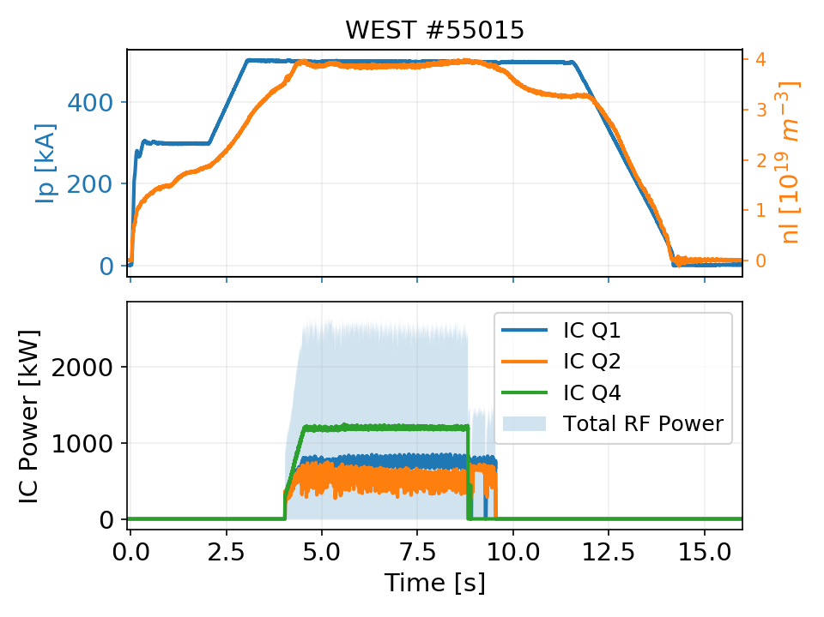
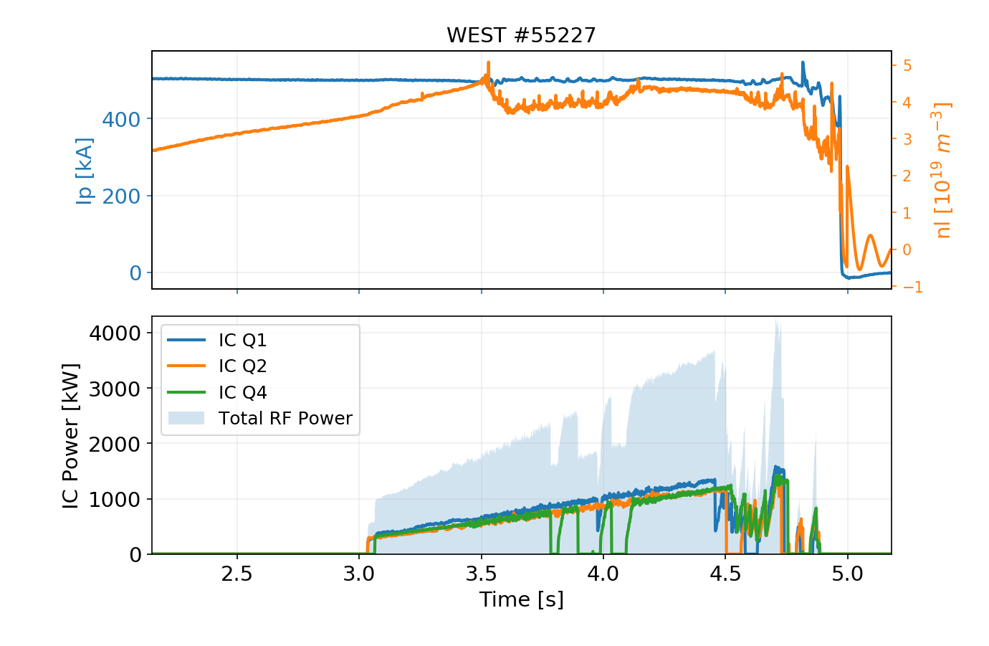
C4 Statistics (preliminary)
Main C4 Results
RF plant reliable due to good maintenance during shutdown
All three antennas operational simultaneously on plasma few times 3 MW/few seconds, 4.2 MW peak.

Slide 6
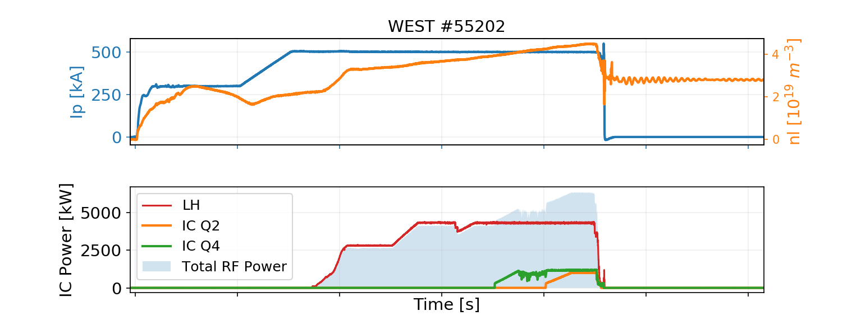
C4 Statistics (preliminary)
Main C4 Results
RF plant reliable due to good maintenance during shutdown
All three antennas operational simultaneously on plasma few times 3 MW/few seconds, 4.2 MW peak.
Up to 2.4 MW (2 antennas) in // with LH (but impurity problem)

Slide 7
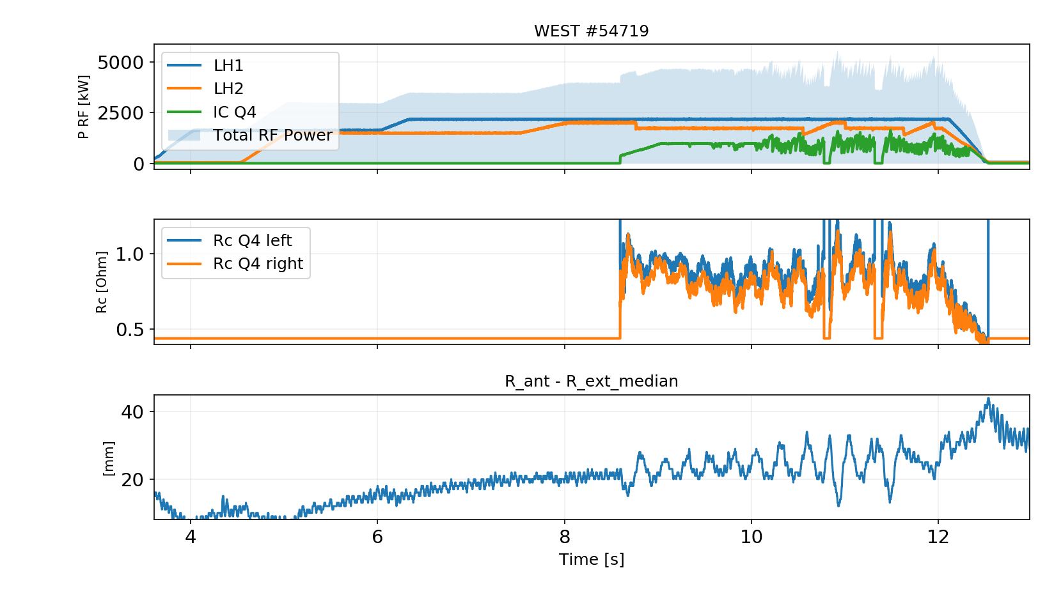
C4 Statistics (preliminary)
Main C4 Results
RF plant reliable due to good maintenance during shutdown
All three antennas operational simultaneously on plasma few times 3 MW/few seconds, 4.2 MW peak.
Up to 2.4 MW (2 antennas) in // with LH (but impurity problem)
Load resilience confirmed

Slide 8
C4 Statistics (preliminary)
Main C4 Results
RF plant reliable due to good maintenance during shutdown
All three antennas operational simultaneously on plasma few times 3 MW/few seconds, 4.2 MW peak.
Up to 2.4 MW (2 antennas) in // with LH (but impurity problem)
Load resilience confirmed
Incidents:
Regular maintenance performed on plant
Delay on Q4 startup due to cabling defects
Few problems with the hydraulic system (cylinders, position encoder) → All solved during maintenance
One voltage probe out of order on Q1 (cable?) →Investigations during S4
One capacitor of Q2 can’t move since its servopack is out of order. Obsolete component, bought online second hand. → Full update of the servomotors and control systems during S4

Slide 9
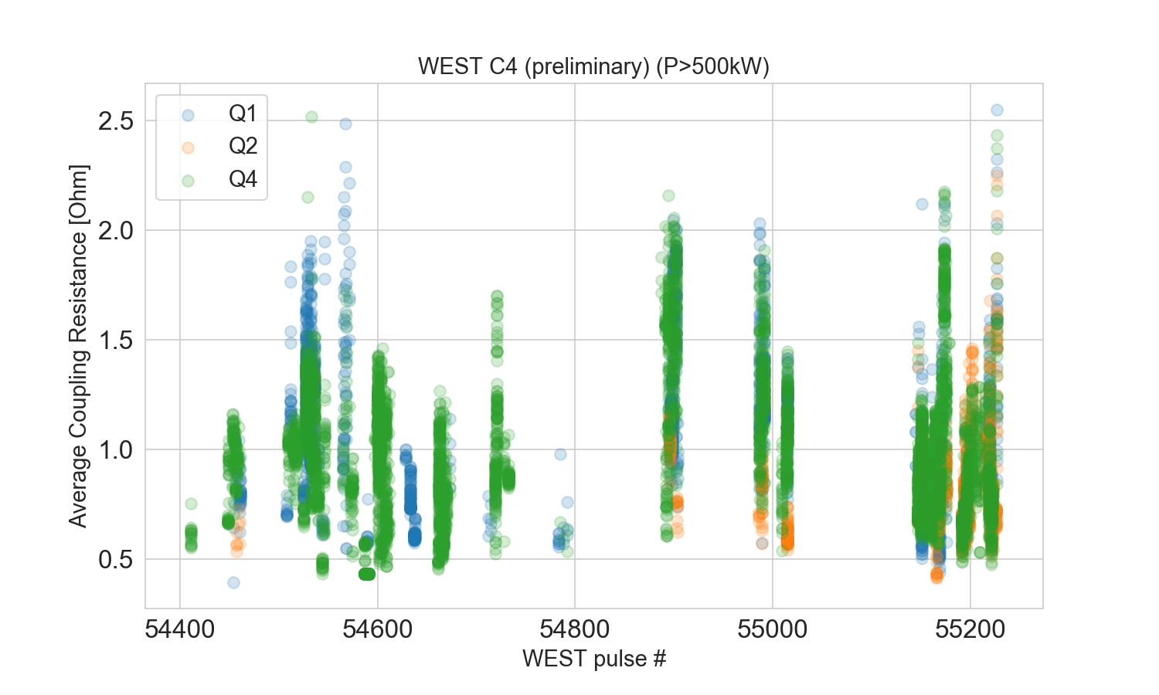
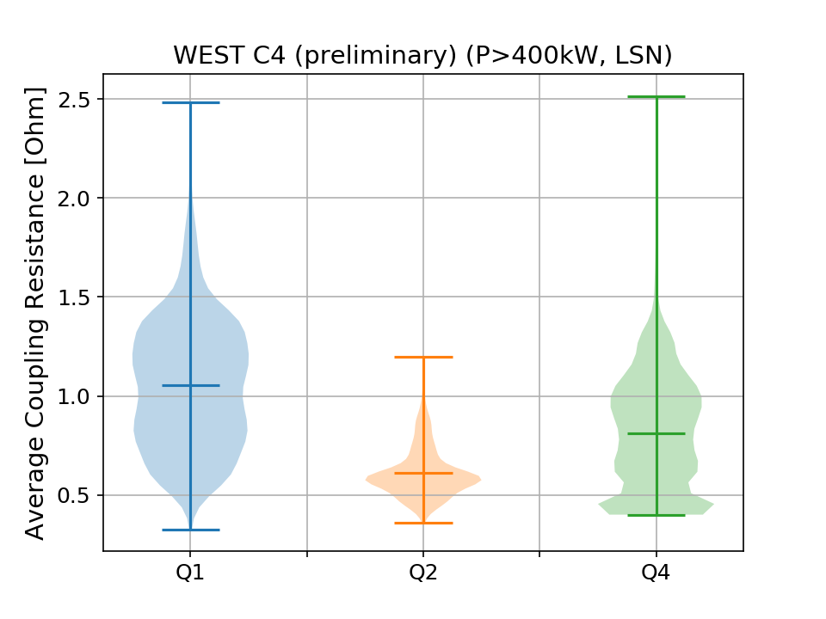
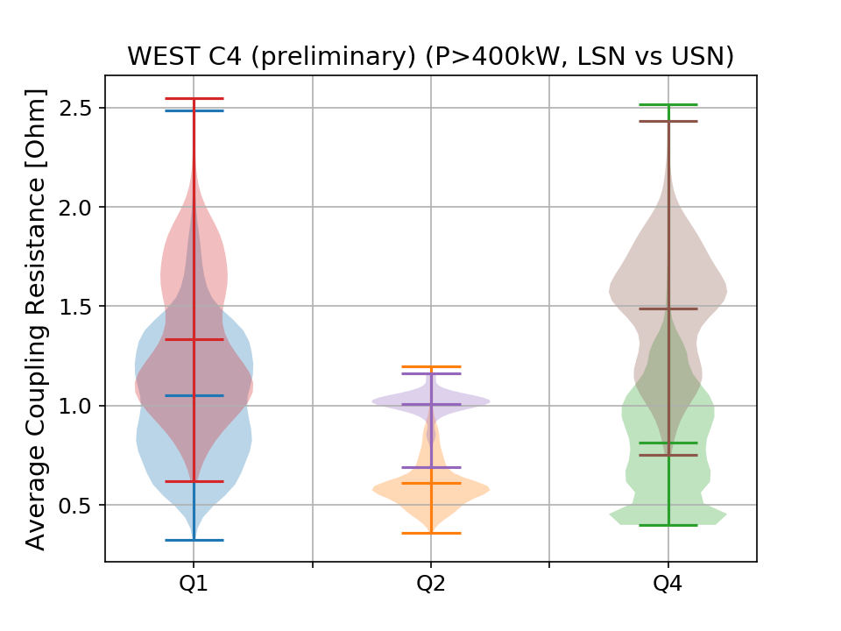
ICRF Coupling during C4 (preliminary)
Still clear difference with Q2
Average coupling resistance for WEST C4 is
between 0.8 -1.0 Ω for Q1 and Q4
Closer to 0.6 for Q2
Clear difference between LSN and USN plasmas for all antennas
Plasma control

Slide 10
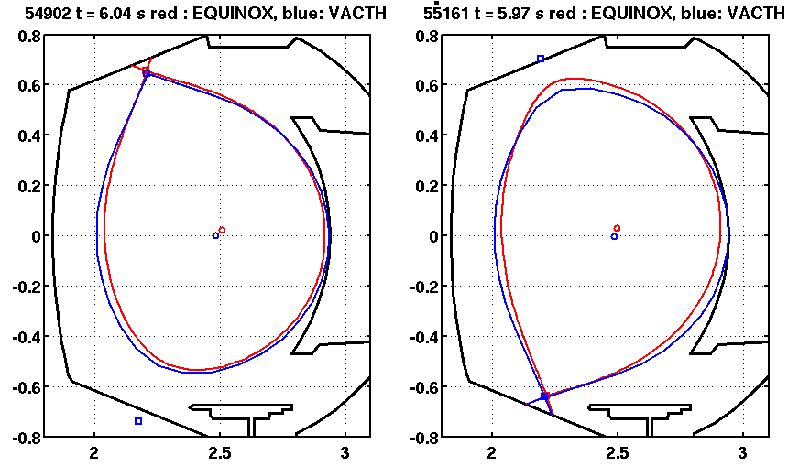
Plasma control
Comparison btw VACTH and EQUINOX equilibrium (500kA/3.6T plasmas)
En USN, différence de l’ordre de 15mm sur le Rext.
En LSN, différence de .. 40mm !
→ Would explain coupling difference measured btw LSN and USN?
Conclusion: probably margin for coupling improvements in C5
From N. FEDORCZAK (18/09)

Slide 11
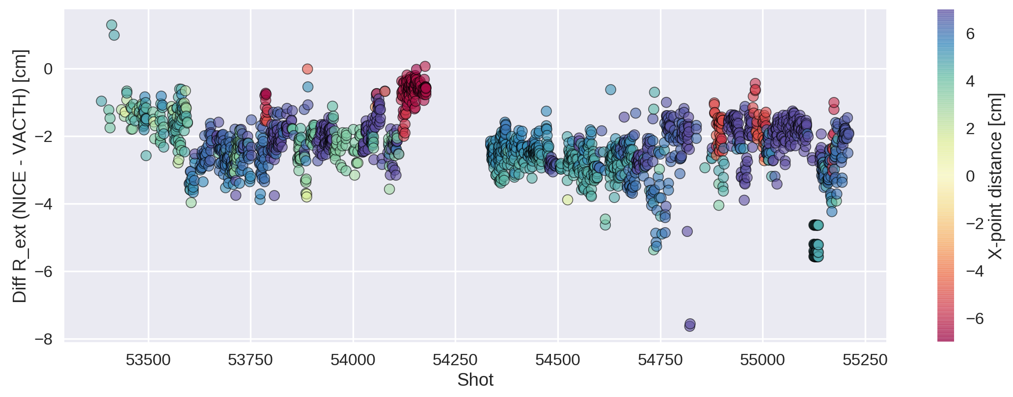
Plasma control
Ecart dans la position R_ext entre NICE et VACTH.
En moyenne il y a un écart de 2cm, la valeur calculé par VACTH est plus grande.
Evolution en fonction du numéro de choc
la différence négative montre que R_ext_vacth > R_ext_nice.
Pour la configuration USN l’écart est légèrement plus faible.
Les points rouges (distance point X négative) sont USN, les points bleus (positifs) sont en LSN.
Bonne soirée,
Jorge
Jorge Morales 23/09/219

Slide 12
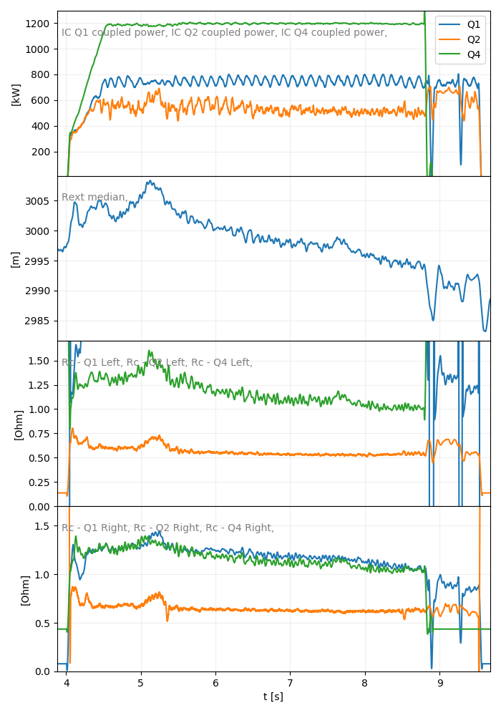
Radial position drift with time ex: #55015
Plasma LCFS moves away from the antennas
Coupling resistances drop
Leads to power regulation and/or trips
Corrections in progress (week 38)
-14mm

Slide 13
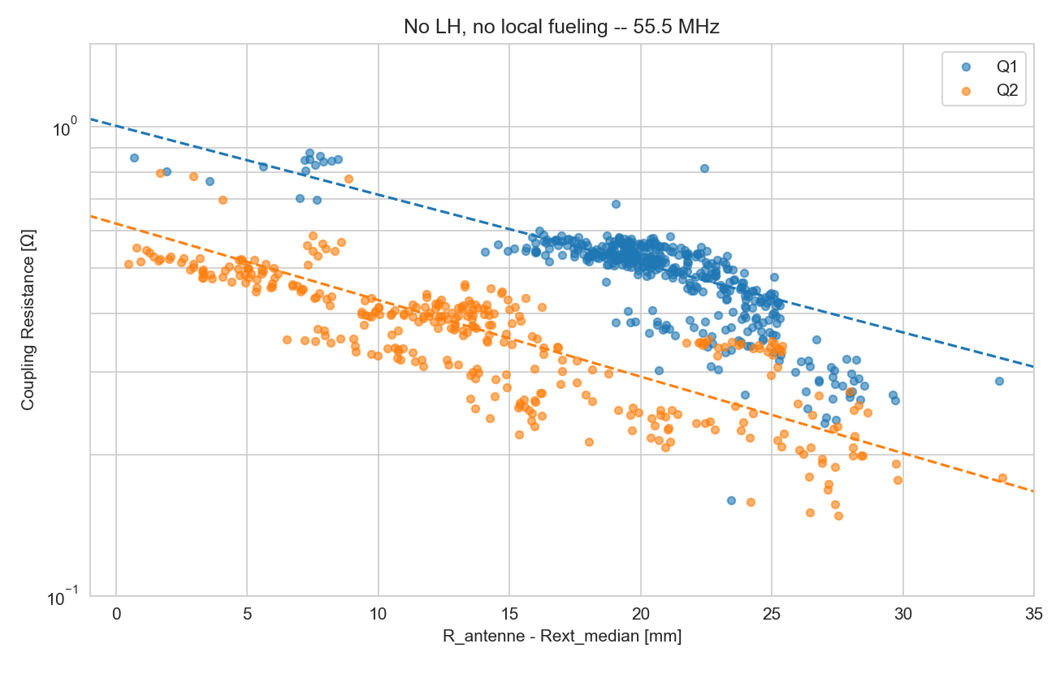
Q2 Coupling Resistance
Q2 coupling resistance has been found different from Q1 during the C3 campaign
Coupling resistance is deduced from voltages and power measurements
→ Power measurements recalibrated during S3, still difference clearly remains.
In C4, the coupling of Q1 and Q4 has been found equivalent.
→ seems to indicate a peculiarity of Q2
Conclusion: difference in Q2 voltage probe calibration as most probable explanation
C3b: Rc vs distance antenna/LCFS
Such behaviour could be explained by a dist. diff. to LCFS ~ 10-15 mm
→ Can’t be explained by mechanical differences (cf. measures), since:
- strap/FS distance is 30.5 mm (-1.6/ +2.2)
⁻ Antenna radial positions checked during S3

Slide 14
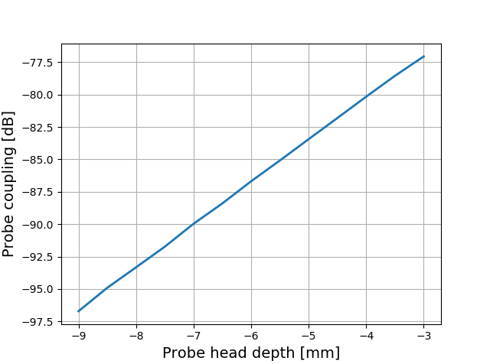
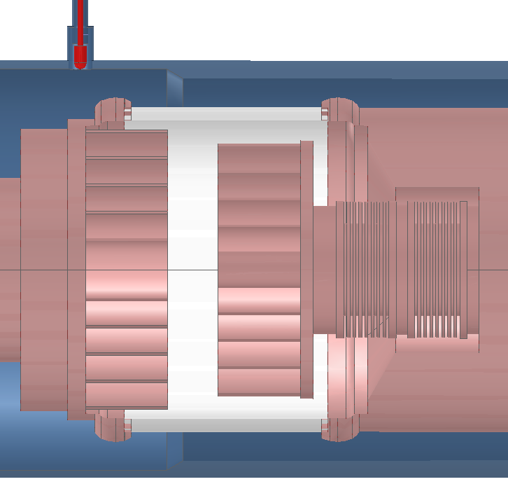
WEST Antenna voltage probe calibration procedure
Probes are calibrated at low frequency (~1 MHz)
Calibration data are then extrapolated to nominal frequencies (48 to 63 MHz)
Probe coupling is *very* sensitive to its depth in its port
Probe head depth
~ 3.3 dB/mm from modelling/measurements
0
Q2 was the first antenna to be assembled and calibrated
Probes have been disassembled then reinstalled *after* the calibration (for welding access) → mechanical error between 1st and 2nd assembly?

Slide 15
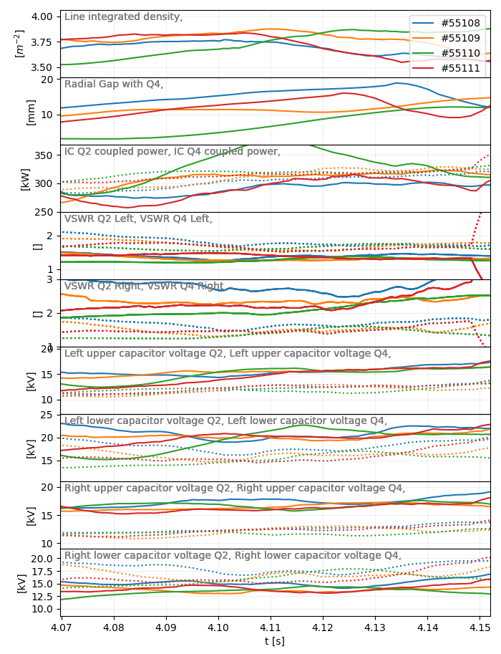
How Q2 voltage probe calibration should be modified to match Q1 and Q4?
From similar shots from Friday 13/09
Voltages compared btw Q2 and Q4 during 4.06 et 4.16 for pulses 55108 to 55114
Caveat: VSWR not exactly identical (frozen capacitor positions)
 | V_{Q2} | V_{Q4} | V_{Q2}/V_{Q4}
Gauche Haut | 15 | 11.95 | 1.25
Gauche Bas | 19.9 | 16.1 | 1.23
Droit Haut | 16.7 | 12.3 | 1.35
Droit Bas | 13.9 | 16.5 | 0.84
V_{Q2} ~ 1.25 x V_{Q4} pour 3 sondes
NB: 20log₁₀(1.25) = 1.94 dB
Correction proposée: -1.94 dB pour ces 3 sondes
→ Erreur de positionnement équivalent à ~ 0.6 mm (crédible)

Slide 16
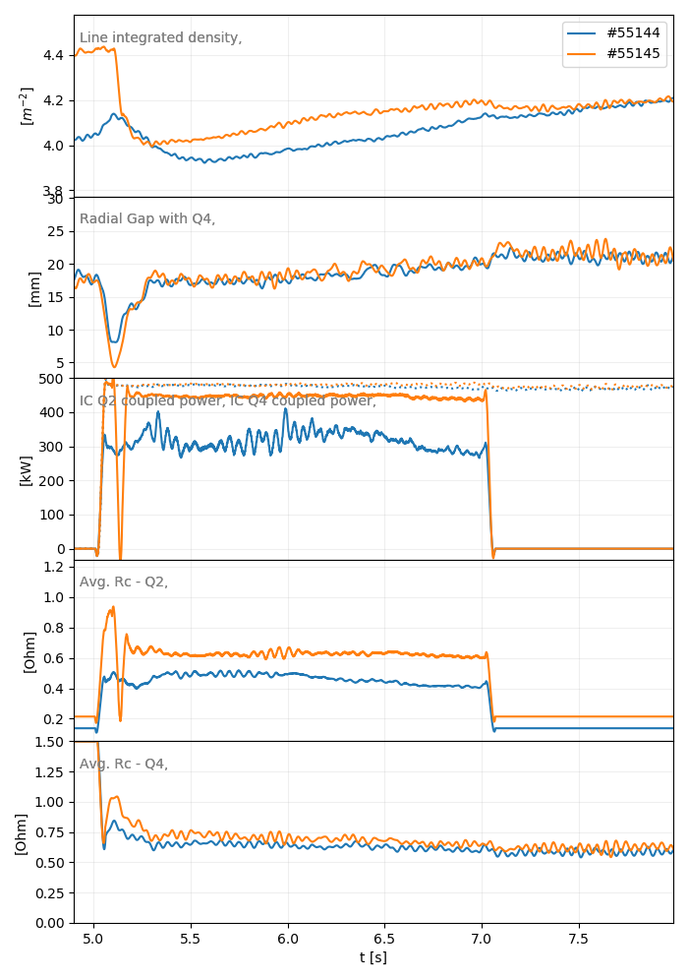
Test of the proposed modification (to be validated)
#55144 vs #55145
→ Q2 Rc increase (consequence of reduced voltages) → No more power regulation and power ~ Q4
Risks: If the cause of voltage differences between Q2 and other antennas is different than a pure calibration problem, it may increase capacitor voltages and currents to:
27 kV x 1.25 = 33.8 kV
915 A x 1.25 = 1143.8 A
Eventually: Measurements could be performed during S4 at low RF power on two antennas (side by side) with machine under vacuum.
Conclusion: validation of this modification?

Slide 17
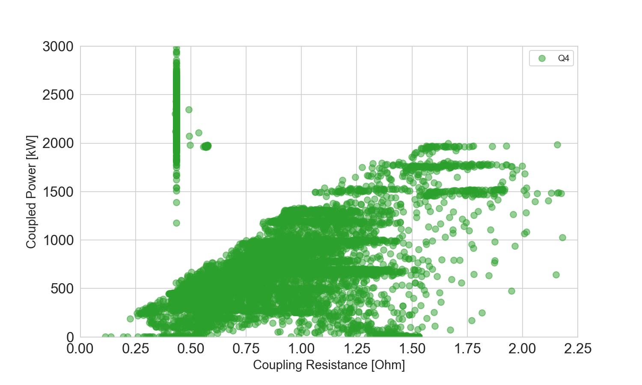
Quelle puissance peut on atteindre?
Si on prend comme référence Q4
2 MW / ant possible si Rc > 1.6 Ohm soit 6 MW pour 3 antennes
Power regulation limit: P_{max}~ 1.2 R_{c}

Slide 18
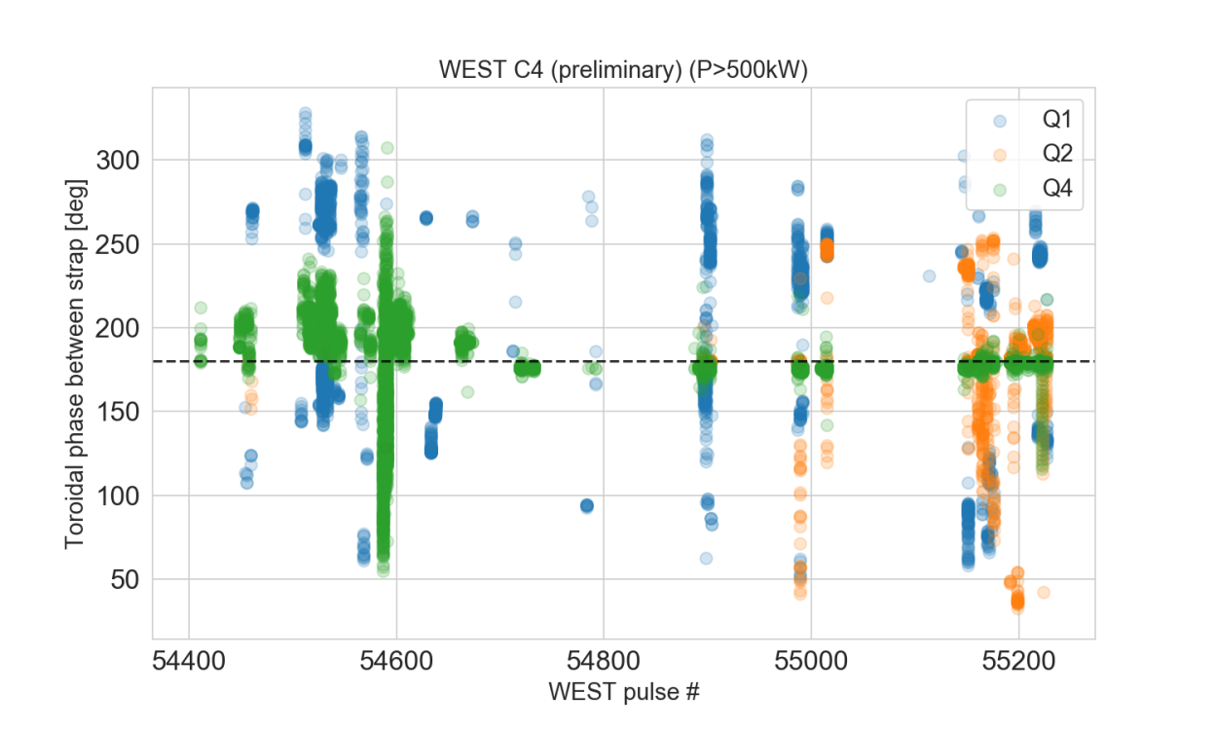
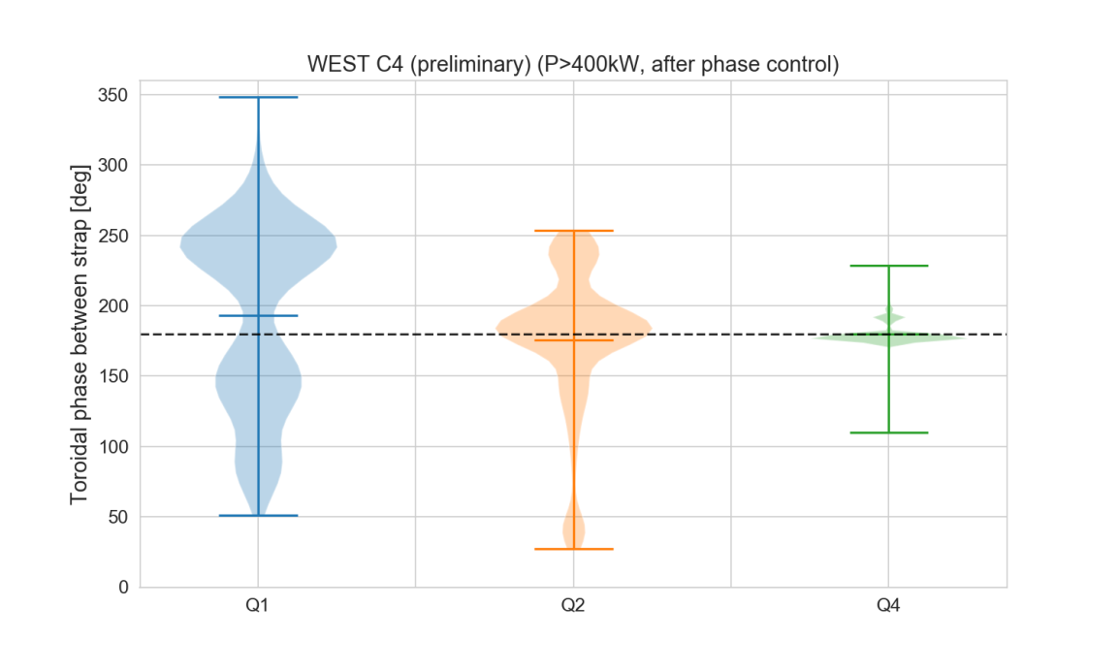
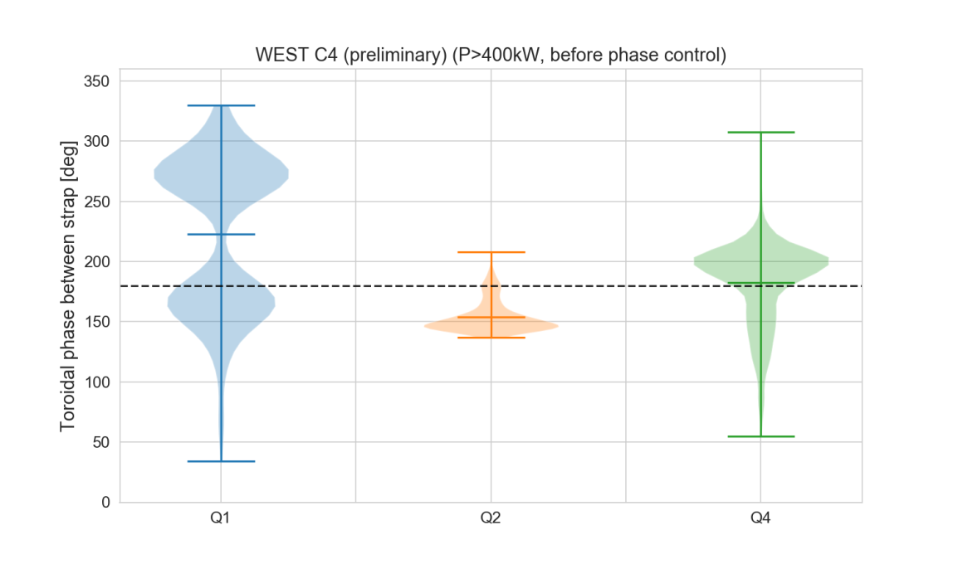
WEST Antenna Toroidal Phase Automatic Regulation
Phase control started since #54626 (but not on all antennas/at the same time)
OK for Q4
Better control for Q2
Does not work on Q1 yet
Conclusion: still margin for improvements. Need to update hardware.

Slide 19
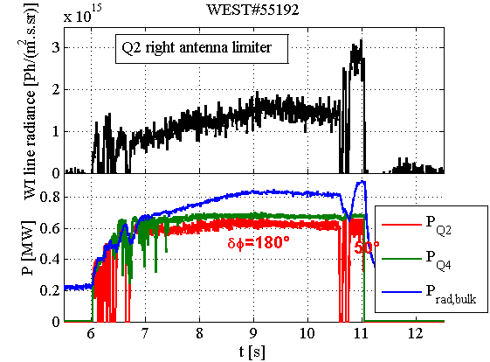
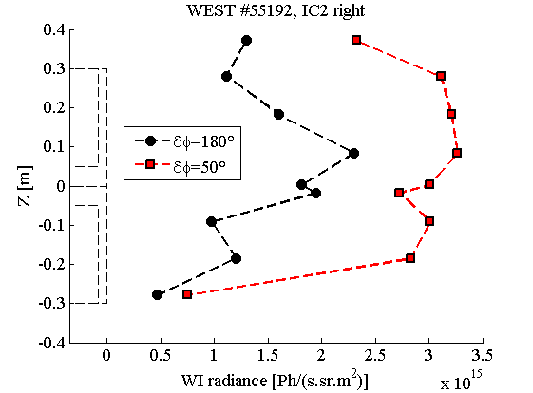
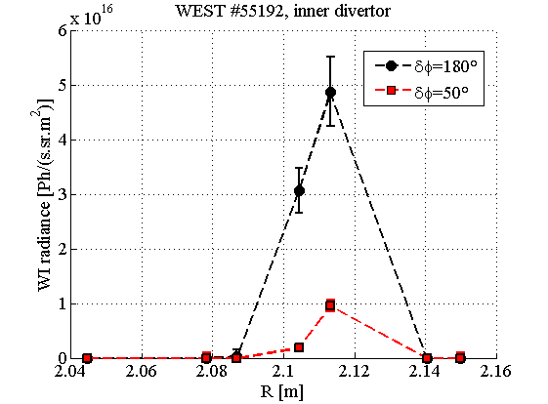
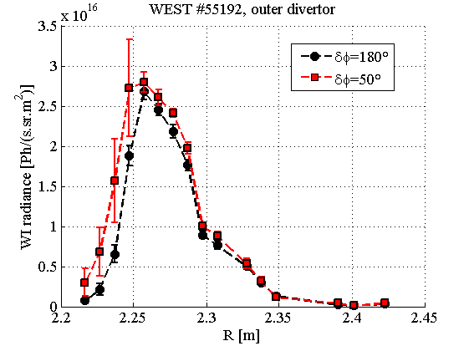
Impurity production vs phase WEST #55192
Failure in Q2 phase control leads to:
Radiated power increase
WI radiance increase on lateral limiters but not on divertor

Slide 20
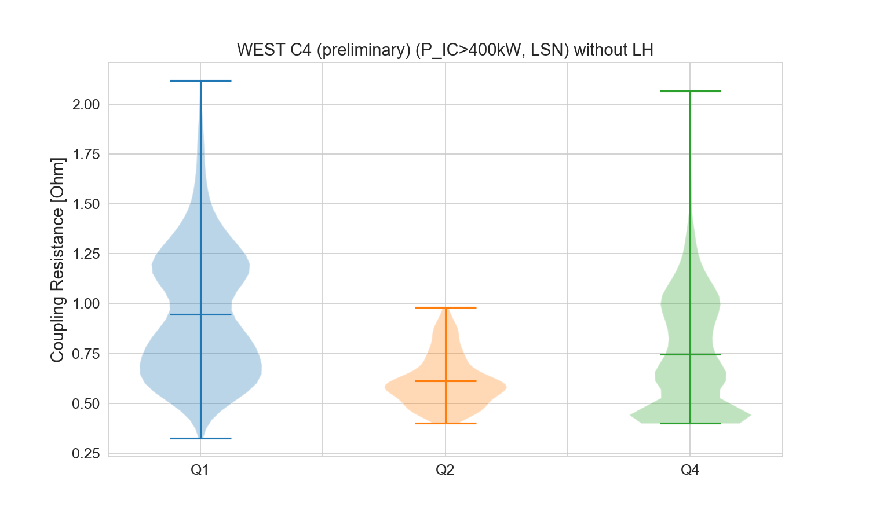
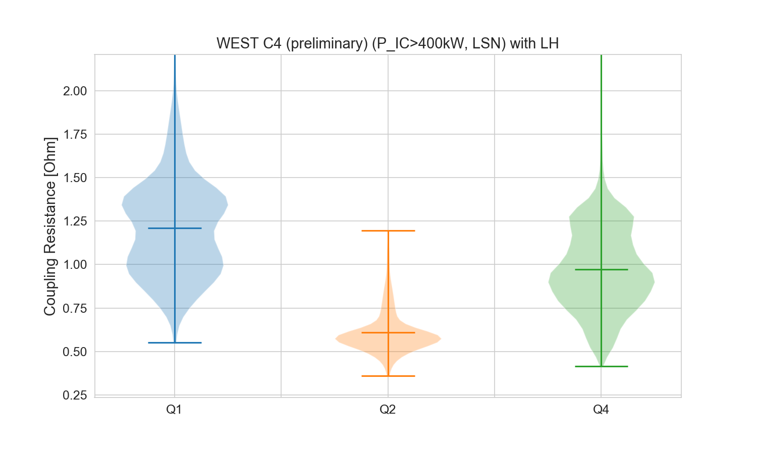
Effect of LH on IC Coupling Resistance
LH power increases the Rc average by 0.25 ohm
But important dispersion: sometime opposite effects measured
Database biased: few shot with LH and Q2

Slide 21
Antenna Modifications
Q: Can we improve coupling by modifying the antennas?
Some ideas:
Reducing the radial gap between antenna limiters and Faraday screen (few mm)?

Slide 22
Impact attendu d’un dépôt de bore sur les protections latérales

Slide 23
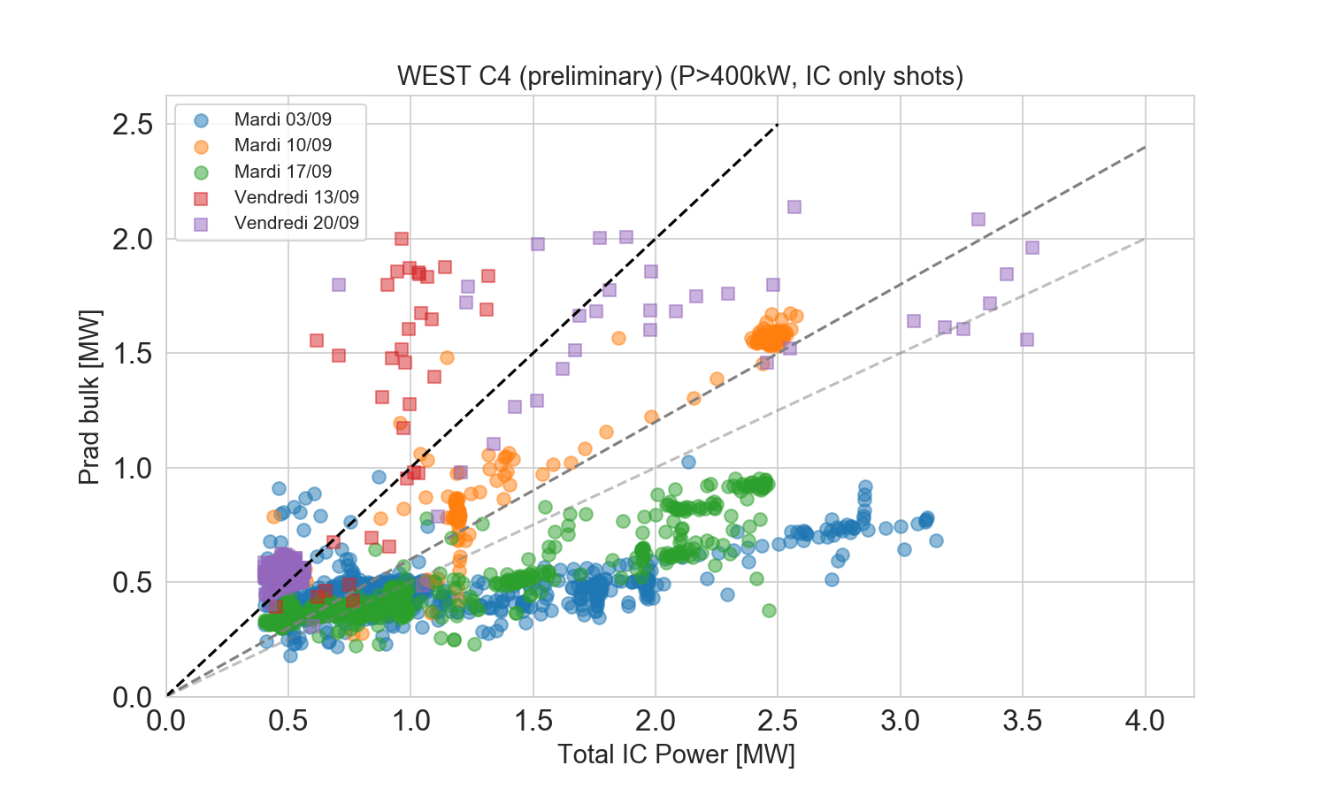
Impact de la boronisation sur la puissance rayonnée (bulk)
f_{rad}=100%
f_{rad}=60%
Phase tests
f_{rad}=50%

